Slide 1
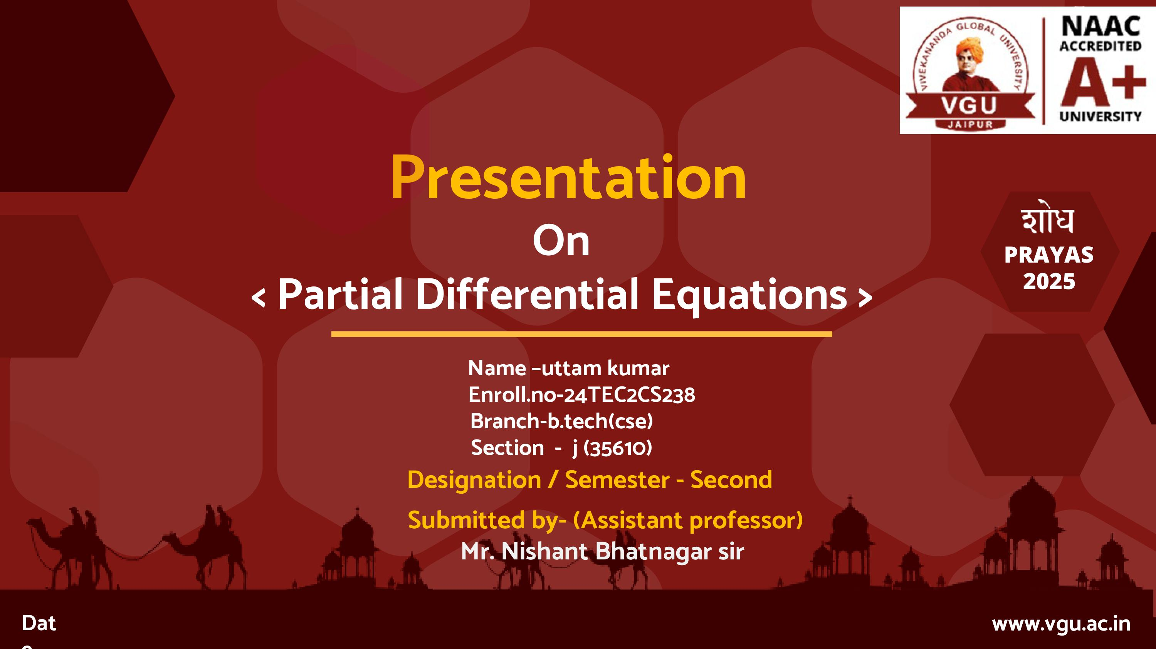
partial differential equations
Submitted By:
Name - UTTAM KUMAR
Enrollment no. - (24TEC2CS238)
A PROJECT REPORT SUBMITTED UNDER A6 COMPONENT OF ENGINEERING MATHEMATICS
Submitted to:
Mr. Nishant Bhatnagar sir

Slide 2
FORMATION OF PARTIAL DIFFERENTIA EQUATIONS
Definition:
A Partial Differential Equation (PDE) is a mathematical equation that involves partial derivatives of an unknown function of two or more independent.
There are two types of PDE:
1.Linear partial differential equation:
first order and first degree (Lagrange’s method)
2.Non linear partial differential equation:
first order but not first degree (Charpit method)

Slide 3
DIFFERENT INTEGRALS OF PARTIAL DIFFERNETIAL EQUATION
1.COMPLETE INTEGRAL SOLUTION - Elemination of two arbitary relation
independent variables.
2) PARTICULAR SOLUTION - f(x,y,z,a,b) = 0 if particular value a and b
3) SINGULAR SOLUTION - f(x,y,z,a,b) = 0 ∂f/∂a = 0 , ∂f/∂b = 0
4) GENERAL SOLUTION - f(x,y,z,a,b) = 0 if b = Φ(a) f(x,y,z,a, Φ(a)) = 0

Slide 4
Lagrange partial differential equation in first order
A linear partial differential equation of order one, Involving a dependent variable z and two independent variables x and y and is of the form Pp + Qq = R where P, Q, R are the function of x, y, z.
Consider,
Pp + Qq = R
Now,
dx/P = dy/Q = dz/R

Slide 5
EXAMPLES
Q. (y² +z²-x²)p – 2xyq = -2zx
Solution:
Pp + Qq = R
on comparing ,
P = y² +z²-x² Q = -2xy R = -2zx
=> dx/ y² +z²-x² = dy/ -2xy = dz/-2zx
=> dy/ -2xy = dz/-2zx
=> ∫ dy/y = ∫ dz/z
=> log Y = log Z + log c
y = cz Ans.

Slide 6
STANDARD TYPES OF FIRST ORDER EQUATIONS Type 1
Partial Differential equation of the form
f(p , q)=0
has solution,
z = ax + by + c and f(a , b)=0

Slide 7
TYPE-2
The partial differentiation equation of the
form
z = ax + by+ f(a , b)
Is called Clairaut's form of partial differential equations.

Slide 8
TYPE-3
If the partial differential equations is given by
f(z, p, q) = 0
Then assume that
z = Φ (x + αy)
u = x + αy
z = Φ(u)
P = ∂Z/∂x = ∂Z/∂u. ∂u/∂x = ∂Z/∂x .1= ∂Z/∂x
q = ∂Z/∂y = ∂Z/∂u. ∂u/∂y = ∂Z/∂u . a = a . ∂Z/∂u. a

Slide 9
TYPE-4
The partial differential equation of the given form can be solved by assuming
f(x , p) = g(y, q) = a
f(x , p)=a => p = Φ(x, a)
g(y , q)=a => q = ψ(y, a)
dz = ∂Z/∂x * dx + ∂Z/∂y * dy
dz = Φ(x, a) * dx + ψ(y, a) * dy

Slide 10
EXAMPLES 1.
1. Solve the PDE p ^ 2 - q = 1 and find the complete and singular solutions
Solution:-
Complete solution is given by
=> z = ax + by + c with
=> a ^ 2 - b = 1
=> b = a ^ 2 – 1
z = ax + (a ^ 2 - 1) * y + c
d.w.r.to. a and c then
∂Z/∂a = x + 2ay
∂Z/∂c = 1 = 0 which is not possible
Hence there is no singular solution

Slide 11
EXAMPLES 2.
2. Solve PDE Pq = Xy
or (∂Z/∂x)(∂Z/∂y)= xy
Solution p/x = y/q
Assume that,
p/x = y/q = a
P = ax ,q = y/a
dz = pdx + qdy = ax dx + y/a*dy
Integrating on both sides
z = a*x^2/2 + y^2+b

Slide 12
Applications
They are widely used in various fields like:
Physics: Modeling heat transfer (heat equation), fluid dynamics (Laplace equation), and wave propagation (wave equation).
Engineering: Designing structures and systems where multiple variables interact.
Mathematics: Used in differential geometry, calculus of variations, and other areas.

Slide 13
Conclusion
Partial Differential Equations (PDEs) are mathematical tools used to describe systems with multiple independent variables and their partial derivatives. They are fundamental in modeling diverse phenomena across science and engineering, providing a framework for understanding and predicting the behavior of complex systems.

Slide 14
Thank you….

